Slide 1
Digital Differential Analyzer Line Drawing Algorithm

Slide 2
A Straight Line Segment
A straight line segment in a scene is defined by the coordinate positions for the end points of the segment.
The graphics system must first project the end points to integer screen coordinates and determine the nearest pixel positions along the line path between the two end points.
A computed line position of (11.48, 21.51), for example, is converted to pixel position (11, 22).
This rounding of coordinate values to integers causes all but horizontal and vertical lines to be displayed with a stair-step appearance.

Slide 3

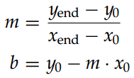
Line Equations
The Cartesian slope-intercept equation for a straight line is
m is the slope of the line and b is the y intercept.
Given that the two end points of a line segment are specified at positions (x0, y0) and (xend, yend), the values for the m and b can be determined with the following calculations.

Slide 4


Line Equations…
For any given x interval δx along a line, corresponding y interval δy can be computed as follows.
Similarly, the x interval δx corresponding to a specified δy can be obtained as
Lines are plotted with pixels, and step size in the horizontal and vertical directions are constrained by pixel separations.
Depending on the value of |m|, axis of sampling should be selected.
|m| < 1, along the x-axis
|m| > 1, along the y-axis

Slide 5
DDA Algorithm
The digital differential analyzer (DDA) is line drawing algorithm based on calculating either δy or δx.
A line is sampled at unit intervals in one coordinate and the corresponding integer values nearest the line path are determined for the other coordinate.

Slide 6
Basic Line and Circle Algorithms
1. Must compute integer coordinates of pixels which lie on or near a line or circle.
2. Pixel level algorithms are invoked hundreds or thousands of times when an image is created or modified.
3. Lines must create visually satisfactory images.
Lines should appear straight
Lines should terminate accurately
Lines should have constant density
Line density should be independent of line length and angle.
4. Line algorithm should always be defined.

Slide 7
Simple DDA Line Algorithm {Based on the parametric equation of a line}
Procedure DDA(X1,Y1,X2,Y2 :Integer);
Var Length, I :Integer;
X, Y, Xinc, Yinc :Real;
Begin
Length := ABS(X2 - X1);
If ABS(Y2 - Y1) > Length Then
Length := ABS(Y2-Y1);
Xinc := (X2 - X1)/Length;
Yinc := (Y2 - Y1)/Length;
X := X1;
Y := Y1;
DDA (digital differential analyzer) creates good lines but it is too time
consuming due to the round function and long operations on real values.
For I := 0 To Length Do
Begin
Plot(Round(X), Round(Y));
X := X + Xinc;
Y := Y + Yinc
End {For}
End; {DDA}

Slide 8
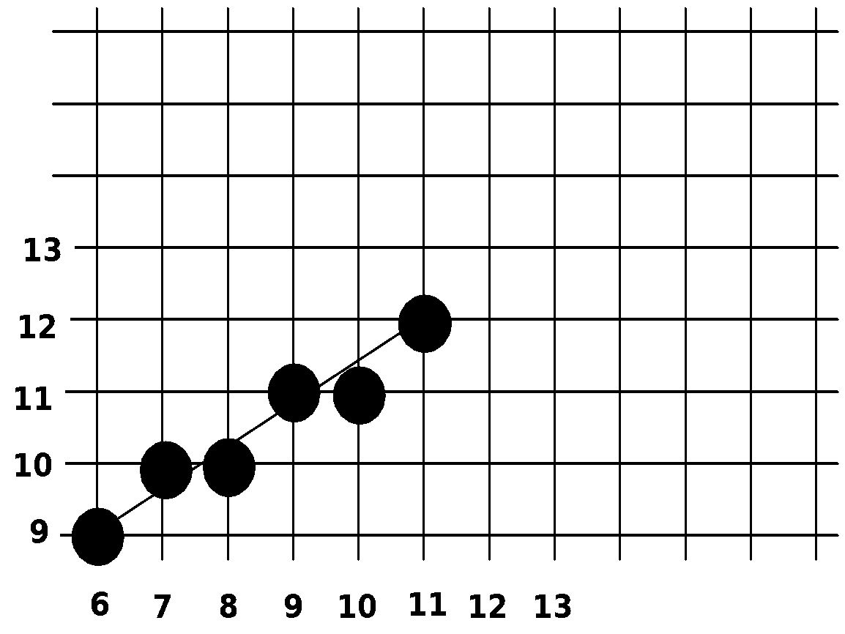
DDA Example
Compute which pixels should be turned on to represent the line from (6,9) to (11,12).
Length := Max of (ABS(11-6), ABS(12-9)) = 5
Xinc := 1
Yinc := 0.6
Values computed are:
(6,9), (7,9.6),
(8,10.2), (9,10.8),
(10,11.4), (11,12)

Slide 9
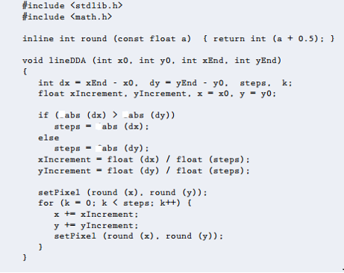
DDA Algorithm…

Slide 10
DDA Algorithm…
The DDA algorithm is a faster method for calculating pixel positions than one directly implements y = m * x + c.
The accumulation of round-off error in successive additions of the floating-point increment, however, can cause the calculated pixel positions to drift away from the true path for long line segments.
The rounding operations and floating-point arithmetic in this procedure are still time consuming.

